Slide 1
BASIC COMP. ARCHITECTURE Bachelor of Computer Science (Hons) (Network Technology and Cybersecurity) MODULE CODE: BCA114

Slide 2
CLO 3
General System Architecture(GSA) and its Basic Principles

Slide 3
Von Neumann Architecture
The Von Neumann architecture, also known as the Von Neumann model and Princeton architecture, is a computer architecture based on that described in 1945 by the mathematician and physicist John von Neumann and others in the First Draft of a Report on the EDVAC(Electronic Discrete Variable Automatic Computer).
This describes a design architecture for an electronic digital computer with parts consisting of a processing unit containing an arithmetic logic unit and processor registers, a control unit containing an instruction register and program counter, a memory to store both data and instructions, external mass storage, and input and output mechanisms.

Slide 4
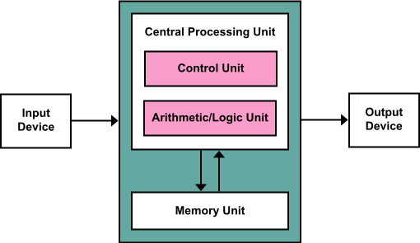

Slide 5
Basic principles
Von Neumann Architecture
5 component design of the stored program digital computer
the instruction cycle
Basic
Exceptions
instruction architecture
software design
hardware circuits

Slide 6
Digital Design
Boolean logic and gates
Basic Combinational Circuits
Karnaugh maps
Advanced Combinational Circuits
Sequential Circuits

Slide 7
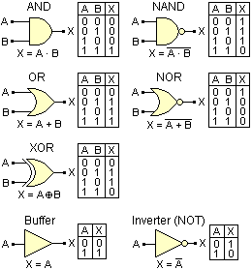
Boolean logic and gates

Slide 8
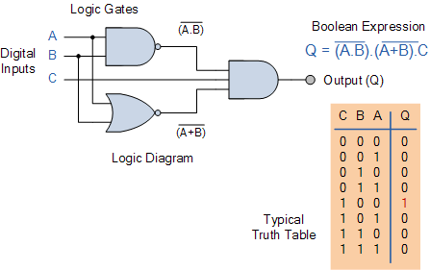
Basic Combinational Circuits

Slide 9
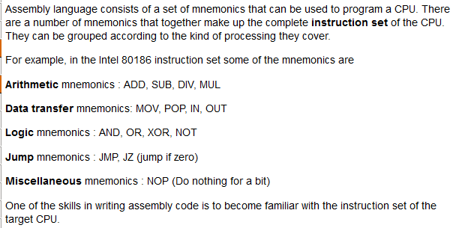

Slide 10
The Karnaugh map It is also known as the K-map, is a method to simplify boolean algebra expressions. Maurice Karnaugh introduced it in 1953 as a refinement of Edward Veitch's 1952 Veitch diagram

Slide 11
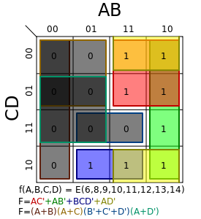

Slide 12
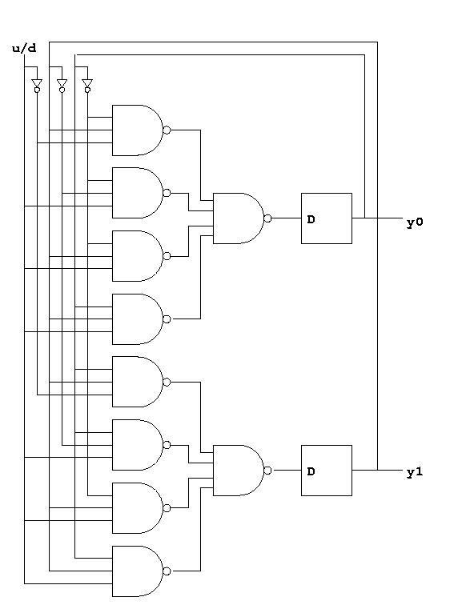
Sequential Circuits

Slide 13
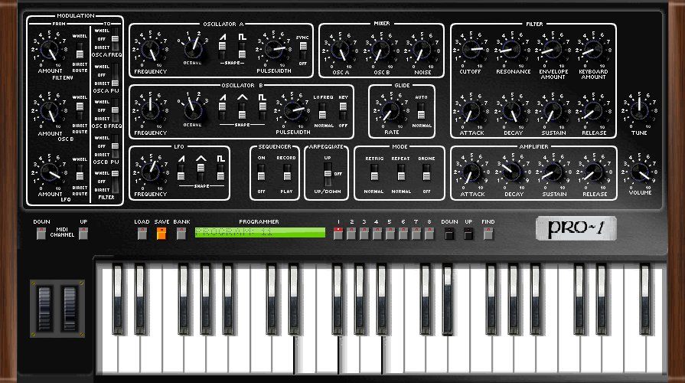

Slide 14
Principles
Data and instructions are both stored in the main memory(stored program concept)
The content of the memory is addressable by location (without regard to what is stored in that location)
Instructions are executed sequentially unless the order is explicitly modified
The basic architecture of the computer consists of:
Computer
Data
CPU
Bus
Main Memory
Control

Slide 15
A more complete view of the computer system architecture that integrates interaction (human or otherwise) consists of:
Computer System
Computer
Input Device
Data
CPU
Main Memory
Bus
Bus
Control
Output Device
Five Main Components:
1. CPU
2. Main Memory (RAM)
3. I/O Devices
4. Mass Storage
5. Interconnection network (Bus)
Bus
Secondary Storage Device

Slide 16
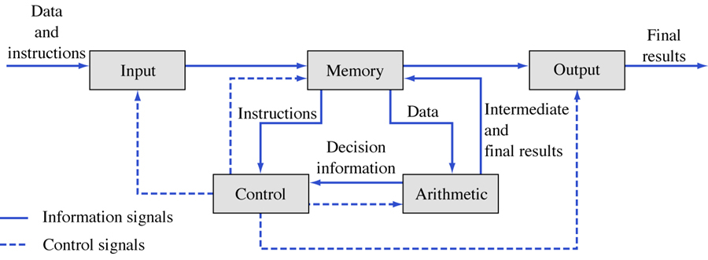
Another view of a digital computer

Slide 17
The Instruction Cycle
The Instruction Cycle
Basic
Intermediate
Exceptions

Slide 18
The Instruction Cycle - Basic View
Once the computer has been started (bootstrapped) it continually executes instructions (until the computer is stopped)
Different instructions take different amounts of time to execute (typically)
All instructions and data are contained in main memory
Start
Fetch Instruction
Execute Instruction

Slide 19
The Instruction Cycle - Intermediate View
Start
Fetch Instruction
A complete instruction consists of
operation code
addressing mode
zero or more operands
immediately available data (embedded within the instruction)
the address where the data can be found in main memory
Decode Instruction
Fetch Operand
Execute Instruction

Slide 20
Opcode & Operand
Opcode : In computing, an opcode (operation code) is the portion of a machine language instruction that specifies the operation to be performed.
Operand : An operand is the object of a mathematical operation, a quantity on which an operation is performed.

Slide 21
The Instruction Cycle - Exceptions
Start
Possible Exception?
Fetch Instruction
Exceptions, or errors, may occur at various points in the instruction cycle, for example:
Possible Exception?
Decode Instruction
Possible Exception?
Fetch Operand
Possible Exception?
Execute Instruction

Slide 22
The Instruction Cycle - Exceptions
Start
Fetch Instruction
Exceptions, or errors, may occur at various points in the instruction cycle, for example:
Addressing - the memory does not exist or is inaccessible
Decode Instruction
Fetch Operand
Execute Instruction

Slide 23
The Instruction Cycle - Exceptions
Start
Fetch Instruction
Exceptions, or errors, may occur at various points in the instruction cycle, for example:
Operation - the operation code does not denote a valid operation
Decode Instruction
Fetch Operand
Execute Instruction

Slide 24
The Instruction Cycle - Exceptions
Start
Fetch Instruction
Exceptions, or errors, may occur at various points in the instruction cycle, for example:
Execution - the instruction logic fails, typically due to the input data
divide by zero
integer addition/subtraction overflow
floating point underflow/overflow
Decode Instruction
Fetch Operand
Execute Instruction

Slide 25
Instruction Architecture
Software design
Hardware circuits

Slide 26
Instruction Architecture - Software Design
Each computer CPU must be designed to accommodate and understand instructions according to specific formats.
Examples:
All instructions must have an operation code specified
NOP no operation
TSTST test and set
OpCode

Slide 27
Instruction Architecture - Software Design
Each computer CPU must be designed to accommodate and understand instructions according to specific formats.
Examples:
Most instructions will require one, or more, operands
These may be (immediate) data to be used directly
or, addresses of memory locations where data will be found (including the address of yet another location)
OpCode
Operand (Address)

Slide 28
Instruction Architecture - Software Design
Sometimes the instruction format requires a code, called the Mode, that specifies a particular addressing format to be distinguished from other possible formats
direct addressing
indirect addressing
indexed addressing
relative addressing
doubly indirect addressing
etc.
OpCode
Mode
Op. (Addr.)
Mode
Op. (Addr.)

Slide 29
Instruction Architecture - CPU
The CPU must be designed to accommodate the instructions and data to be processed
I/O 1
I/O 2
I/O n
System Bus
CPU
RAM
System Bus
ALU
Regs
Address Bus
Control Bus
Data Bus
PC
CU
IR
Internal
CPU Bus
PSW

Slide 30
Instruction Architecture - Hardware Circuits
Everything that the computer can do is the result of designing and building devices to carry out each function – no magic!
At the most elementary level the devices are called logic gates.
There are many possible gate types, each perform a specific Boolean operation (e.g. AND, OR, NOT, NAND, NOR, XOR, XNOR)
ALL circuits, hence all functions, are defined in terms of the basic gates.
We apply Boolean Algebra and Boolean Calculus in order to design circuits and then optimize our designs.

Slide 31
Instruction Architecture - Hardware Circuits
Data is represented by various types of “signals”, including electrical, magnetic, optical and so on. Data “moves” through the computer along wires that form the various bus networks (address, data, control) and which interconnect the gates.
Combinations of gates are called integrated circuits (IC).
All computer functions are defined and controlled by IC’s of varying complexity in design. The manufacture of these may be scaled according to size/complexity:
LSI large scale integration
VLSI very large scale integration
ULSI ultra large scale integration

Slide 32
Instruction Architecture - CU
The control unit must decode instructions, set up for communication with RAM addresses and manage the data stored in register and accumulator storages.
Each such operation requires separate circuitry to perform the specialized tasks.
It is also necessary for computer experts to have knowledge of the various data representations to be used on the machine in order to design components that have the desired behaviours.

Slide 33
Instruction Architecture - ALU
All instructions together are called the instruction set
CISC complex instruction set
RISC reduced instruction set
Each ALU instruction requires a separate circuit, although some instructions may incorporate the circuit logic of other instructions

